Slide 1
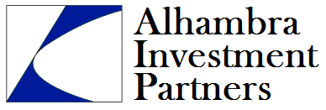
We Are Different.
A Registered Investment Advisory Firm

Slide 2
We Are Different.
Alhambra
Traditional
Advisor
Independent
Decision Makers
Academic Research
Portfolios Designed to Perform
Fiduciary Duty To Client
Dedicated to Client Success
Salesman
Biased
Order Takers
Marketing Research
Products Designed to Sell
Acts for Benefit of Management
Dedicated to Own Success

Slide 3
Alhambra Your Personal CFO
Fiduciary Duty: We have a legal obligation to do what is in your best interest. Conflicts of interest, if any, must be disclosed.
Experience: Our investment team has over 75 combined years of investment experience.
Objectivity: We are paid by and work solely for our clients. We are not paid by any third party mutual funds or brokerage firms.
Transparency: Clients custody their own funds. We act as investment managers but clients retain control of their assets. Performance information is compiled and made available via Morningstar’s client portal.

Slide 4
Our Preferred Custodians
One of the world’s largest financial services providers with total custodied assets of $3.4 trillion.
Provides access to a wide variety of financial products and services.
Insurance and annuities through Fidelity Life Insurance.
SIPC and unlimited supplemental account insurance.
Required no government assistance during financial crisis.
Innovative On Line Brokerage firm.
Founded in 1999 by ex-SEC commissioner Steve Wallman.
SIPC and supplemental account insurance up to $10 million.
Required no government assistance during financial crisis.

Slide 5
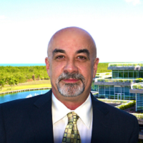
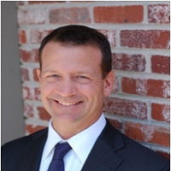
People
Joseph Y. Calhoun III
Founder, Chief Investment Architect
20 Years Experience
US Navy Veteran
Widely published market commentary
Editor at Real Clear Markets
Douglas R. Terry
Head of Portfolio Implementation
Over 15 Years Experience
Extensive Derivatives and Risk Management Experience
Floor trader: CBOT, NYMEX, COMEX & CBOE

Slide 6
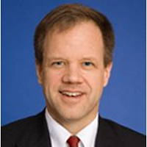
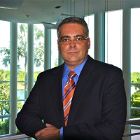
People
John L. Chapman
Chief Economist, research focus on monetary policy, macroeconomic growth & global opportunities
Marketing and systems engineering at IBM
Strategy consulting at Hill & Cutler Co.
Private equity, M&A, corporate finance advisory at Global Capital Markets, Inc.
Widely published in Wall Street Journal, Real Clear Markets, et al.
Doctorate in Economics (Univ. of Georgia), Harvard MBA, CFA Candidate
Blog site at www.ThinkingThingsOver.com
Joseph A. Gomez
University of Miami, Finance
20-years in the wealth management industry
Extensive experience in fee-based asset management, portfolio construction and risk management
Advises U.S. and offshore clients

Slide 7
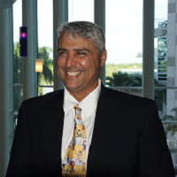
People
Orlando Casariego
Chief Operating Officer
Mechanical Engineer
Principal, 3C Construction
Extensive real estate investment & management experience

Slide 8
Investment Philosophy
Both Have Merit
Strategic Investing
Tactical Investing

Slide 9
Strategic Investing Process
Modern Portfolio Theory
Multiple Asset Classes
5 Key Asset Classes
Efficient Portfolios
Conservative
Moderately Conservative
Moderately Aggressive
Aggressive
Dynamic Rebalancing
Based on business cycle theory
Maximize momentum effect

Slide 10
Tactical Investing Process
Macroeconomic Analysis
Classical/Austrian Theory
Reject Mainstream Keynesian View
Monetary and Fiscal Policy
Portfolio Level Risk Adjustment
Conservative
Moderately Conservative
Moderately Aggressive
Aggressive
Fundamental Analysis
Domestic v. International
Large Cap v. Small Cap
Treasury v. Risk bonds
ETFs, individual securities

Slide 11
Client Assessment
Individual Circumstances
Risk Versus Return
Goals
Aspirations
Income
Net Worth
Current Investments
Savings Strategy
Plans
Ability to accept Risk
Willingness to accept Risk
Behavioral Economics
Concept of Risk
Volatility
Loss of Principal
Ability to recover

Slide 12
Customized Investment Solution
World Allocation
Global Opportunities
World Bond
Tax Free
Select Countries
Trend Follower Models

Slide 13
Reach Your Financial Goals With Alhambra
Academically supported process and strategy
Superior risk adjusted performance
Customized solutions
Low turnover, tax efficient portfolios
Classical/Austrian economic theory – the only theory that fully explains the real economy.
Fiduciary duty to client
Independent – No conflicts of interest
Alhambra Partners
We Are Different.

Slide 14
Unbiased and Independent Advisor

Slide 15
Offices and Contact Information
South Office Palmetto Bay Village Center 18001 Old Cutler Road, Ste. 409 Palmetto Bay, Florida 33157
786-249-3773
Coral Gables Office Douglas Road Entrance, South Tower 806 Douglas Road, Ste. 625 Coral Gables, Florida 33134
786-249-3773 Denver, Co Office 7887 East Belleview Avenue, Ste. 1100 Greenwood Village, Colorado 80111
303-228-1677
Alhambra Partners
We Are Different.

Slide 16
Disclaimer
Past performance may not be indicative of future results. Different types of investments involve varying degrees of risk, and there can be no assurance that the future performance of any specific investment, investment strategy, or product made reference to directly or indirectly in this communication, will be profitable, equal any corresponding indicated historical performance level(s), or be suitable for your portfolio and may result in a loss of principal. Due to various factors, including changing market conditions, the content may no longer be reflective of current opinions or positions. Moreover, you should not assume that any discussion or information contained herein serves as the receipt of, or as a substitute for, personalized investment advice from Alhambra Investment Partners, LLC.

